Slide 1
Decoding dots and dashes: Building a Morse Code Translator

Slide 2
Ujku i Debores
Team Members:
Joel Bitri

Slide 3
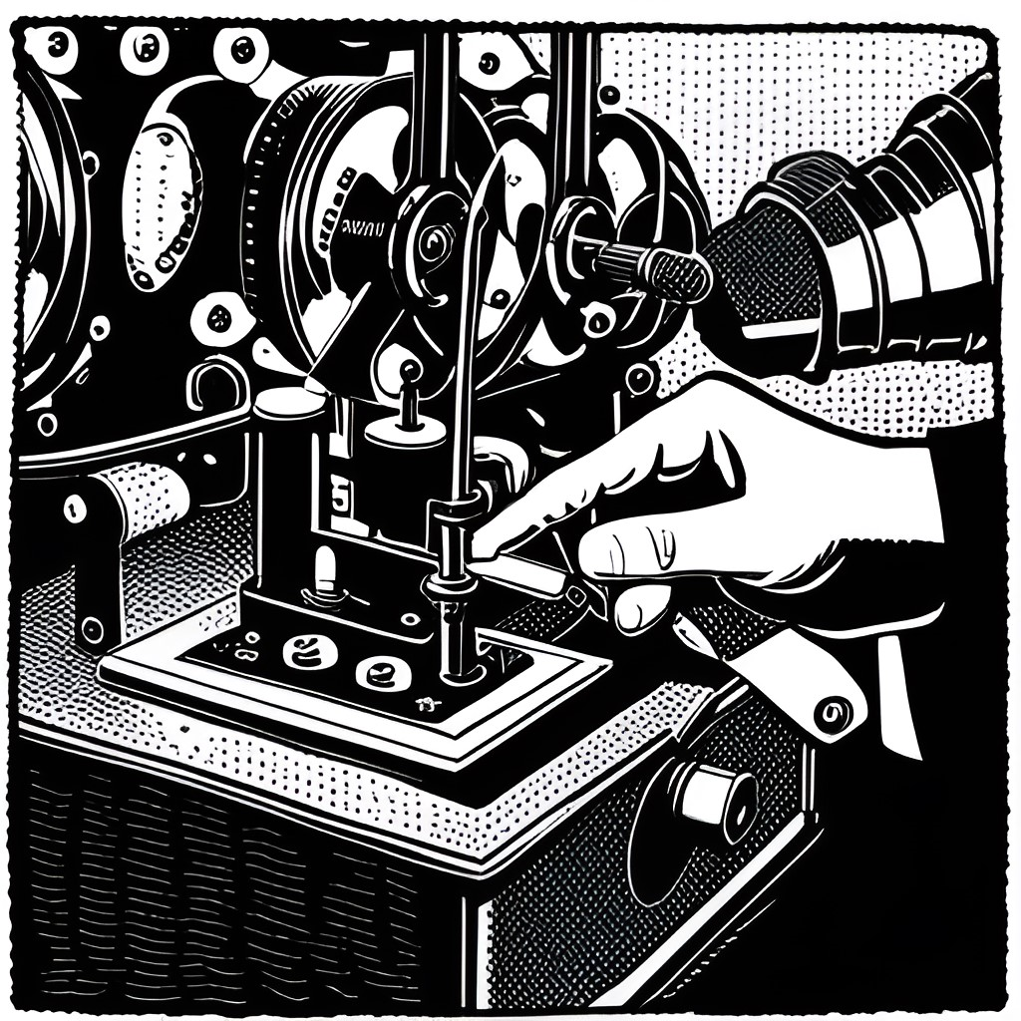
Introduction to Morse Code
Morse code is a method of communication that uses a series of dots and dashes to represent letters and numbers. It was invented in the early 1830s by Samuel Morse and Alfred Vail, and was originally used for telegraphy.
Today, Morse code is still used by amateur radio operators, pilots, and other groups who need to communicate over long distances or in situations where other forms of communication may not be available.

Slide 4

Git and Repository Management
We used Git to manage our code repository and collaborated on the development branch. We made sure to commit frequently and leave descriptive commit messages to keep track of changes made by each team member. We also used branches to work on different features and merged them back into the development branch once they were completed and tested.
Here is a screenshot of our repository, showing the development branch and the history of commits made by each team member. We found Git to be an essential tool for managing our codebase and collaborating effectively as a team.

Slide 5
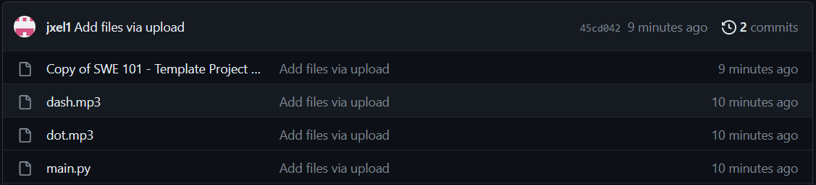
Git Repository

Slide 6

Creating a Morse Code Translator in Python
Python is a popular programming language for beginners because it has a simple syntax and is easy to learn. In this project, we will create a Morse code translator using Python.
To start, we will need to create a dictionary that maps each letter and number to its corresponding Morse code sequence. We can then use this dictionary to translate any text input into Morse code.

Slide 7
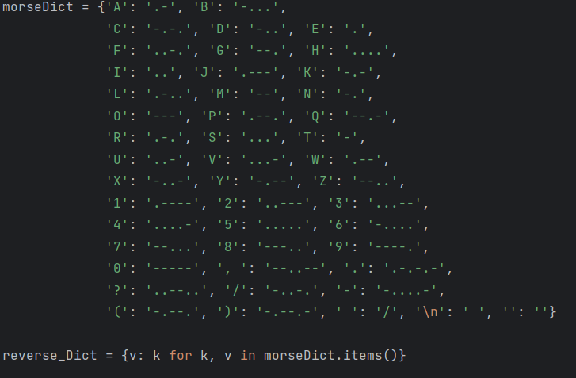
The English to Morse Dictionary and The Morse to English Dictionary
Here are the 2 dictionaries that help with the translation of the morse code. The first one is the standard english to morse dictionary.
And the second one is a for loop which switches the first dictionary around. Keys become values and vice versa.

Slide 8
Functional Requirements

Slide 9
The program should support both Morse code to text and text to Morse code translation.
The program should allow users to input Morse code signals through a variety of methods, including audio input and keyboard input.
The program should support multiple languages for text output.
The program should have a user-friendly graphical user interface (GUI) that allows users to easily input Morse code and view the translated text.
The program should have a command-line interface (CLI) for advanced users.
The program should support file input and output, allowing users to translate entire files of Morse code signals or text.
The program should support real-time translation of Morse code signals received through an audio input source.
The program should be able to handle interruptions during Morse code signal input, such as pauses between letters and words.
The program should play audio output of translated Morse code signals.

Slide 10
Different Usages of The Morse Code Translator

Slide 11
Business Scenario: A small communication company has a need to communicate messages to their remote field staff, who may not have access to the internet or a phone signal. They want to use Morse code to transmit these messages but do not have staff who are proficient in Morse code. They require a tool that can quickly and easily translate text into Morse code and vice versa, allowing them to communicate with their field staff effectively.
Amateur Radio: Morse code is still widely used by amateur radio operators, particularly in contests and emergency communication situations. A Morse code translator can help them decode messages received in Morse code and translate them into text.
Military and Aviation: Morse code has historically been used in military and aviation contexts for communication purposes. While it is less common today due to advanced technology, some military and aviation personnel may still be trained in Morse code. A translator can assist them in decoding messages or brushing up on their skills.
Signaling and Distress Calls: Morse code can be used as a signaling method in various situations, such as at sea or in outdoor activities like hiking or mountaineering. If someone is in distress and can communicate using Morse code, a translator can be used to interpret the message and provide assistance.
Historical Purposes: Morse code played a significant role in telecommunications history. Morse code translators can be used by historians or enthusiasts to interpret historical messages or documents encoded in Morse code.
Morse Code Artifacts: Morse code can be found in various artifacts, such as old telegrams, telegraphs, or military equipment. Translators can be utilized to decipher these artifacts and understand their content.

Slide 12

Adding User Input and Error Handling
To make our Morse code translator more user-friendly, we can add a function that prompts the user to enter a message to be translated.
We can also add error handling to our functions to handle cases where the user enters invalid input, such as characters that are not in our dictionary or Morse code sequences that are not valid.

Slide 13

Decisions and Limitations
During the development process, we had to make several decisions regarding the design and implementation of our Morse code translator. For example, we decided not to include a feature for translating Morse code audio to text because it would have required complex signal processing algorithms. Instead, we focused on creating a simple and user-friendly interface for text-based translations.
We also faced some technical limitations, such as the limited support for non-Latin characters in the Python programming language. However, we were able to work around these limitations by using external libraries and implementing custom solutions. Overall, we believe that these decisions and workarounds helped us create a functional and efficient Morse code translator.

Slide 14
Future Implementations
Voice Recognition: A future Morse code translator could include voice recognition capabilities. This would enable users to input Morse code messages by speaking them aloud, and the translator would convert the spoken Morse code into text.
Mobile Applications: Morse code translators could be developed as mobile applications for smartphones and tablets. These apps could offer additional features such as tutorials, practice exercises, and customizable settings for personalized learning.
Machine Learning and Artificial Intelligence: By leveraging machine learning and artificial intelligence techniques, a Morse code translator could continuously improve its accuracy and adaptability. It could learn from user inputs, correct errors, and provide more precise translations over time.
Integrated Communication Platforms: Morse code translators could be integrated into existing communication platforms, such as messaging apps or email clients. This would allow users to send and receive messages in Morse code within the same interface they use for other forms of communication.
Customizable Audiovisual Feedback: Morse code translators could provide customizable audio and visual feedback options. Users could choose from various sound patterns, tones, or visual cues to suit their preferences and enhance the learning or decoding experience.
Accessibility Features: Future Morse code translators could incorporate accessibility features to assist individuals with visual or hearing impairments. For example, they could offer text-to-speech capabilities for audio output or visual aids for easier interpretation of Morse code signals.

Slide 15
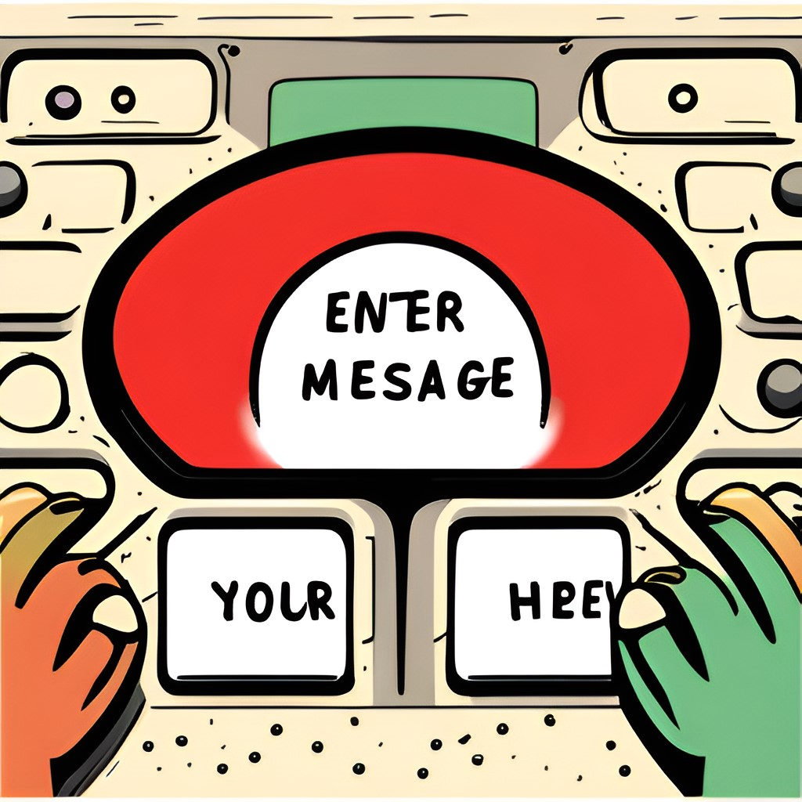
To wrap things up
In this project, we have learned how to create a Morse code translator using Python. We started by creating a dictionary that maps each letter and number to its corresponding Morse code sequence.
We then used functions to translate text to Morse code and Morse code back to text, and added user input and error handling to make our program more user-friendly. With these skills, we can create many other useful programs using Python.

Slide 16
Thank you for watching!

